Slide 1
A Capstone Project on Telecom Customer Churn Prediction Using Machine Learning
By: Varun Jhalani
Batch: PGA 02 JPR
Date: 05-06-2023

Slide 2
Introduction & Problem Statement
Welcome to the Telco Customer Churn Project presentation.
In this project we will explore the critical issue of customer churn in the telecommunications industry and discuss our efforts to reduce customer attrition.
Customer churn is the percentage of customer stopped using Companies product that company offer for a specific period of time.
This project aims to leverage advanced data analytics and predictive modeling techniques to identify key factors contributing to customer churn and develop effective strategies to mitigate it.

Slide 3

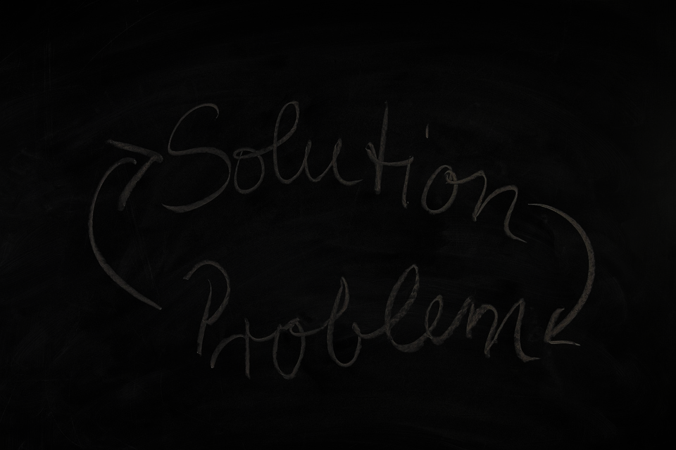
Problem Statement
Telco companies face the challenge of high customer churn rates in the telecommunications industry.
Competition, network quality, customer service, and pricing strategies contribute to customer dissatisfaction and churn.
Losing customers not only impacts the Company's Revenue but also indicates underlying problems with service quality, customer satisfaction, and overall customer experience.
Our project aims to address these challenges and develop data-driven solutions to reduce churn rates, retain valuable customers, and enhance customer loyalty.
This Photo by Unknown Author is licensed under CC BY-SA-NC

Slide 4
Objectives
Analyze historical customer data to identify churn patterns and trends.
Identify key factors influencing customer churn.
Develop targeted retention strategies to reduce churn rates.
Implement proactive measures to improve customer satisfaction and loyalty.
Monitor and evaluate the effectiveness of implemented strategies.
Build predictive models to forecast customer churn probability.

Slide 5
Proposed Methodology
GET DATA
Gather comprehensive customer data from the source.
ANALYSIS & Preprocessing
Conduct exploratory data analysis to uncover insights.
TRAIN MODEL
TEST
REFINE
Test the model on testing data
Outliers Detection
Evaluate and improve Model Accuracy by applying more model and hyperparametric tuning.
Train the data on Model
Perform Encoding etc.
Deployment
Build a Predictive Machine learning model

Slide 6
Dataset Description
The Dataset Consist of 7043 number of Customer Records and there are 21 columns.
There is few missing values present in the dataset.
Churn is the Target variable which shows that weather a customer is churned or not.
Variables:
customerID
gender
Whether the customer is a male or a female
SeniorCitizen
Whether the customer is a senior citizen or not
Partner
customer ID
Whether the customer has a partner or not
Dependents
Whether the customer has dependents or not
Tenure
Number of months the customer has stayed with the company
PhoneService
Whether the customer has a phone service or not

Slide 7
MultipleLines
Whether the customer has multiple lines or not
InternetService
Customer’s internet service provider
OnlineSecurity
Whether the customer has online security or not
OnlineBackup
Whether the customer has online backup or not
DeviceProtection
Whether the customer has device protection or not
TechSupport
Whether the customer has tech support or not
StreamingTV
Whether the customer has streaming TV or not
StreamingMovies
Whether the customer has streaming movies or not
PaymentMethod
The customer’s payment method
Contract
The contract term of the customer
PaperlessBilling
Whether the customer has paperless billing or not
MonthlyCharges
The amount charged to the customer monthly
TotalCharges
The total amount charged to the customer
Churn
Whether the customer churned or not

Slide 8
Necessary Packages
Numpy : Numpy is a library for the Python programming language, adding support for large, multi-dimensional arrays and matrices, along with a large collection of high-level mathematical functions to operate on these arrays.
Pandas : Pandas is an open source Python package that is most widely used for data science/data analysis and machine learning tasks. It is built on top of another package named Numpy, which provides support for multi-dimensional arrays.
Matplotlib : Matplotlib is one of the plotting library in python which is however widely in use for machine learning application with its numerical mathematics extension- Numpy to create static, animated and interactive visualizations.
Seaborn : Seaborn is a library for making statistical graphics in Python. It builds on top of matplotlib and integrates closely with pandas data structures. Seaborn helps you explore and understand your data.
Sklearn : Scikit-learn (Sklearn) is the most useful and robust library for machine learning in Python. It provides a selection of efficient tools for machine learning and statistical modeling including classification, regression, clustering and dimensionality reduction via a consistence interface in Python.

Slide 9
Steps taken for Data Cleaning
1
Some of the Columns are renamed
2
Changed data type of text column to numerical
3
Checked for Null Value and found that 11 null values are present in total_charges
Since only 0.15% data have null values. We can remove these data from the dataset.
After removing null values, we have 7032 rows.
4
Deleted Irrelevant columns(Customer_id) from the data
5
For most of the categorical columns, there are same different words with same meaning --> "no" and "No internet service"

Slide 10
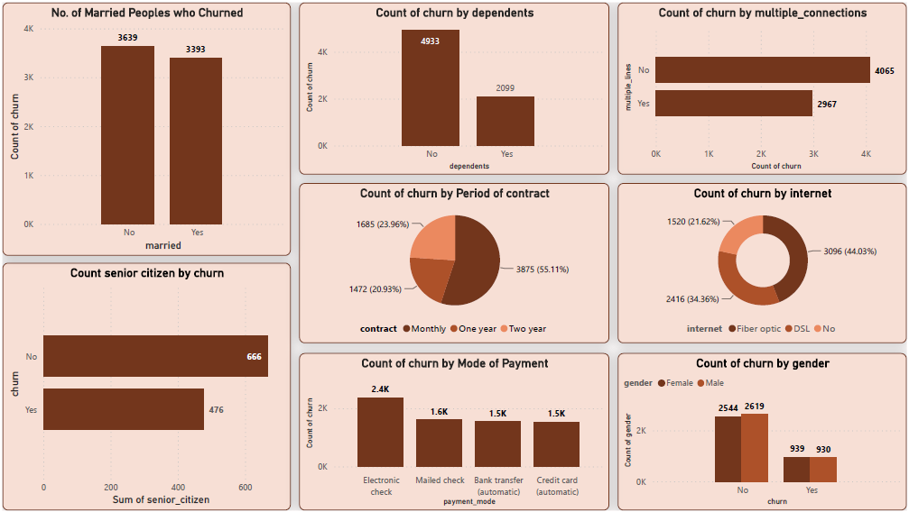
Visualizing the data using Power Bi

Slide 11
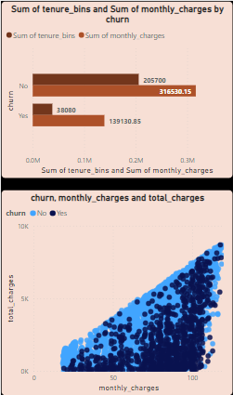
Analysis Conclusion
UNIVARIATE ANALYSIS
Approximately same rate of churn in male and female
Churn rate is lower in Senior Citizens.
Churn rate is high in non-married customers
Churn rate is same in multiple and non-multiple line customers
Most of the people are on monthly contract which also have highest churn rate. and Very low churn rate is in two year contract.
Customers who are paying using Electronic Check has high churn rate
Many Churned users only have 5 or lower months of tenure.
Data is highly imbalanced as there is only 26.5% of churned users in this dataset.
Hence resampling is required
BIVARIATE ANALYSIS
Total Charges increases as Monthly Charges increases.
Higher Churn rate at lower total charges.
Higher churn rate when tenure is less and monthly charges are high.
Higher churn rate when tenure is high and contract is of two years.

Slide 12
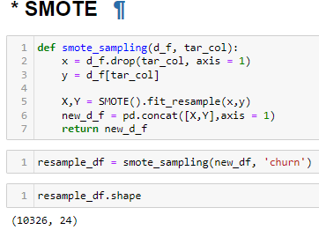
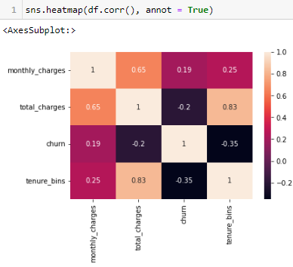
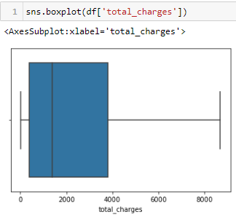
Data Preprocessing
Correlation:
Tenure has 80% correlation with Total Charges.
We will keep both the columns, as both are important for churn prediction
Outliers:
No outliers were detected in the data.
Encoding:
Created dummies for various categorical columns
Handling Imbalance:
Applied SMOTE to remove misbalancing of dataset
For Scaling I used Standard Scaler

Slide 13
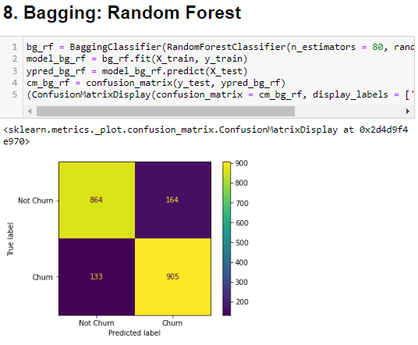
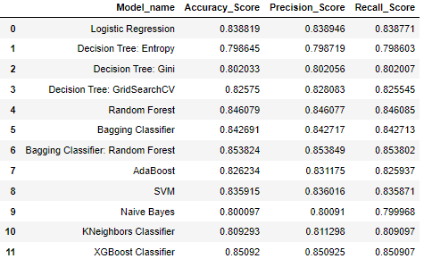
Machine Learning Model

Slide 14
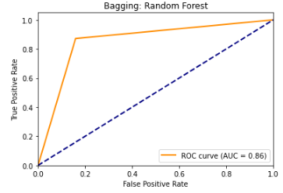
Why Random Forest with Bagging Classifier?
Random Forest with Bagging Classifier is a machine learning algorithm that combines the concepts of bagging and decision trees to create an ensemble model.
Bagging: Bagging is a technique that involves training multiple models on different subsets of the training data, obtained through sampling with replacement. Each model is trained independently on a random subset of the data.
It is based on the concept of ensemble learning, which is a process of combining multiple classifiers to solve a complex problem and to improve the performance of the model.
Voting and Aggregation: For classification tasks, the random forest combines the predictions of individual decision trees using majority voting. For regression tasks, the predictions are aggregated, typically by taking the average.

Slide 15

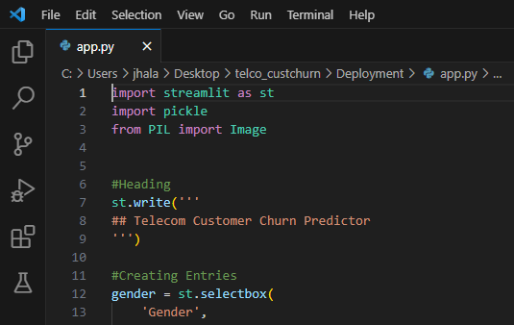
Model Deployment
What is Model Deployment?
Deploying a machine learning model, known as model deployment, simply means to integrate a machine learning model and integrate it into an existing production environment where it can take in an input and return an output.
Steps taken to deploy our project:
Exported our best performing model using pickle library
Used VSCode to create Entry Columns and to create environment for our model
Uploaded our pickle file, VSCode file and other supporting file on HuggingFace.com which is a hub of open source models.

Slide 16
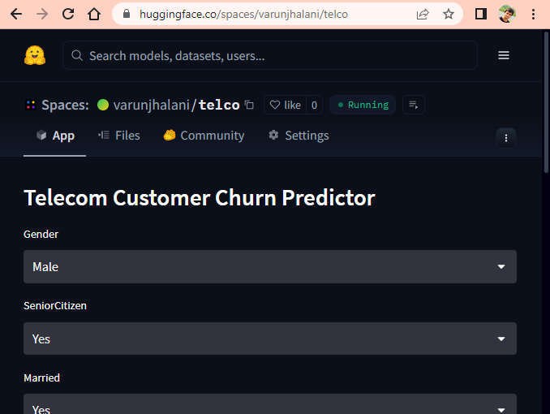
Conclusion
Click on image for Live Demonstration.
My Telco Customer Churn Machine Learning project successfully addresses the challenge of customer churn prediction in the telecommunications industry.
I developed a robust and accurate model that identifies potential churners in our customer base using advanced machine learning techniques.
The project followed a systematic approach, including data preprocessing and feature engineering, to ensure data quality and relevance.
After evaluating multiple machine learning algorithms, I selected the best-performing model for deployment.
The developed API provides a user-friendly interface for seamless interaction with the churn prediction functionality.
With our solution, we are well-equipped to tackle customer churn and drive the growth and success of our telco business.

Slide 17
THANK YOU

